Slide 1
Tirgul 1
Introducing HUJI-CSE environment
Introduction to Python

Slide 2
Before We Start
We don’t assume you have any previous experience
Many important tools are learned in the course!

Slide 3
Today’s Objectives
Course basics (Course guidelines, Moodle, getting help )
How to submit exercises - ex1 is already online
Work environment (Course 67100, Installing Pycharm, CS labs + Linux)
Getting started with Python

Slide 4
Intro - course guidelines
Could be found at the course’s website (here), very (!!) important to read.
Guidelines highlights :
How to contact the course staff
Course grade = 50% (best of n-1) exercise + 50% exam
one of the excercises is a project worth 2 exercises
Exercises – recommendations, roles, scoring and appeals.
Code efficiency matters - Don’t repeat code, make use of functions.
Style matters - Following the coding style in Intro’s website is obligatory.

Slide 5
Intro - Course guideline cont.
NO CHEATING we take it very seriously.

Slide 6
Intro - Contacting the course staff
General questions → General questions forum
Questions about specific exercise → Exercise question forum
Appeals → Appeals forum will be opened after all exercises are checked
No personal emails please (we can’t track them, we won’t answer them)
Individual requests →private request forum

Slide 7
Intro – Lab hours
In addition to your lectures and tirguls, you have additional 2 weekly lab hours.
In the lab you will solve a quiz with some questions and problems about the material of the same week. You can work there on your exercises as well.
You don’t have to go to the labs or answer the quiz (although it’s highly recommended to do so!), but if you do, you will get a Magen of up to 15% to your final grade.

Slide 8
Intro - Additional ways to get help
Lab support - can be found at CS labs (Rotberg building, room c100). Question you can ask lab support :
I need help with installing Pycharm on my laptop
I don’t know why my program isn’t compiling
I read the week’s lectures and Tirgulim but still am not sure how to get started with the exercise
System group : system@cs.huji.ac.il
Technical problems and questions

Slide 9
Intro basics
Intro website (Moodle) : https://moodle2.cs.huji.ac.il/nu19/course/view.php?id=6710102
Get to know the website :
Forums (for asking questions)
Register to course’s forum to get email notifications and updates. It is your responsibility to stay updated with forum announcements.

Slide 10
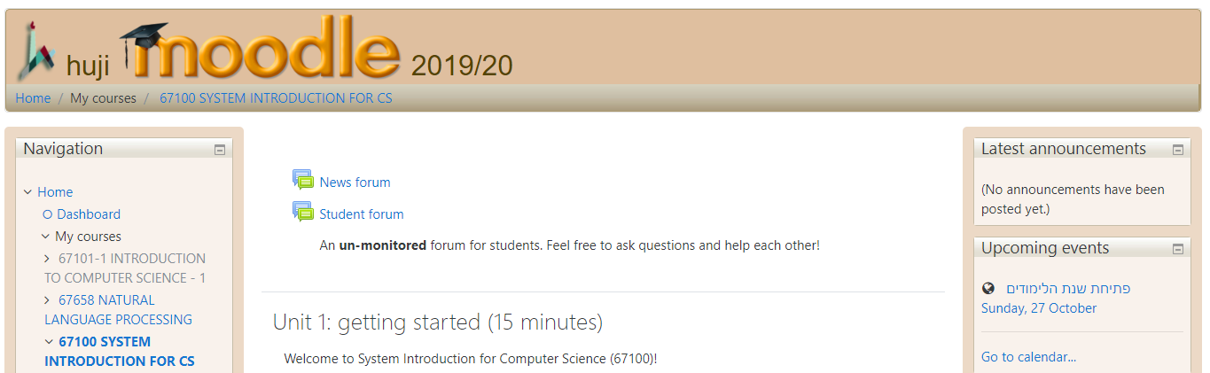
Course 67100
Covers all you need to know about CS & Linux work environment !
We will assume you are familiar with the material in future lectures.

Slide 11
General - Welcome to HUJI CS
Every cs student has two e-mail accounts:
login@cs.huji.ac.il (provided by cs department)
firstname.lastname@mail.huji.ac.il (provided by the university)
Your cs email messages are automatically forwarded to your mail.huji account.
More about the cs mail: http://wiki.cs.huji.ac.il/wiki/Mail
The university e-mail site is: http://mail.huji.ac.il
Explanation and details on HUJI mail : http://ca.huji.ac.il/gmail

Slide 12
General - Welcome to HUJI CS
Connecting from outside :
OTP – One-Time Password: is a safe dynamic password. One needs OTP to access the CSE network from outside.
All details about connecting to the CSE network from outside can be found at: http://wiki.cs.huji.ac.il/wiki/Connecting_from_outside
Introduction to CS computing system (Login, space quotas, backups, file system, Linux): http://wiki.cs.huji.ac.il/wikis/MediaWiki/cs/images/cs/images/c/c9/Intro2CSE.pdf

Slide 13
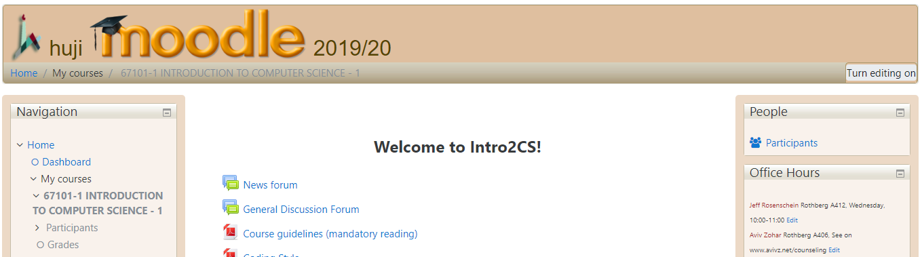
Office hours
For any question regarding the course material.

Slide 14
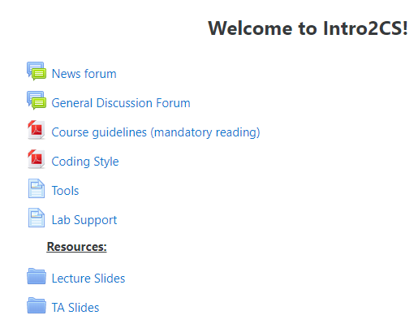
Intro basics
All the slides of lectures and tirguls will be uploaded to the moodle:

Slide 15
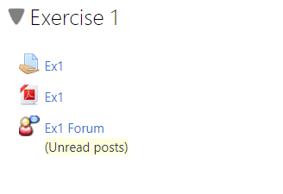
Intro exercise submission
Your execrises will also be published through the moodle. ex1 is already online

Slide 16
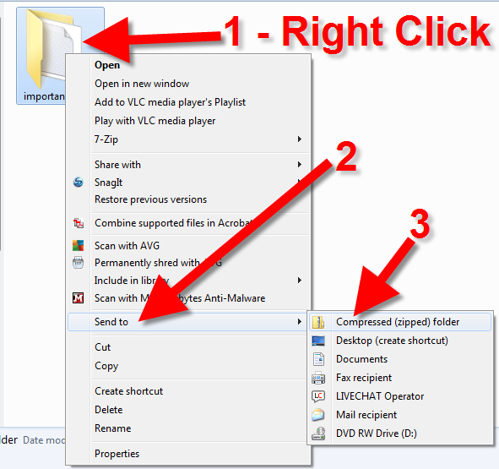
How to submit an exercise?
The submitted solution should include just one file. To group all your files together (e.g. my_solution1.py, my_soution2.py) zip them together.
You can submit as many times as you wish, only the last submitted version will be checked.

Slide 18

CS labs
CS labs use an OS you might heard of - Linux.
What is an OS? An operating system is a program which intermediate between the user, hardware and other applications.
Some OS we are familiar with are : Windows, Mac OS, iOS, Android, Linux
Linux is an open-source, free, widely distributed OS.

Slide 19
Your CS account
Every user has her own resources : Environment, folders, backups, etc.
To know more, follow the introduction to CS computing system
To login, use your CS username and password.
A short intro to CS lab environment → After logging in you’ll see ...

Slide 20
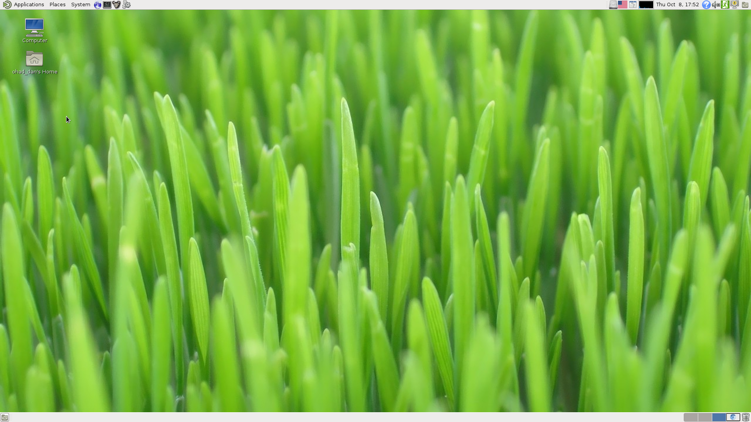
This
To get started you can

Slide 21
Open browser (Iceweasel)

Slide 22
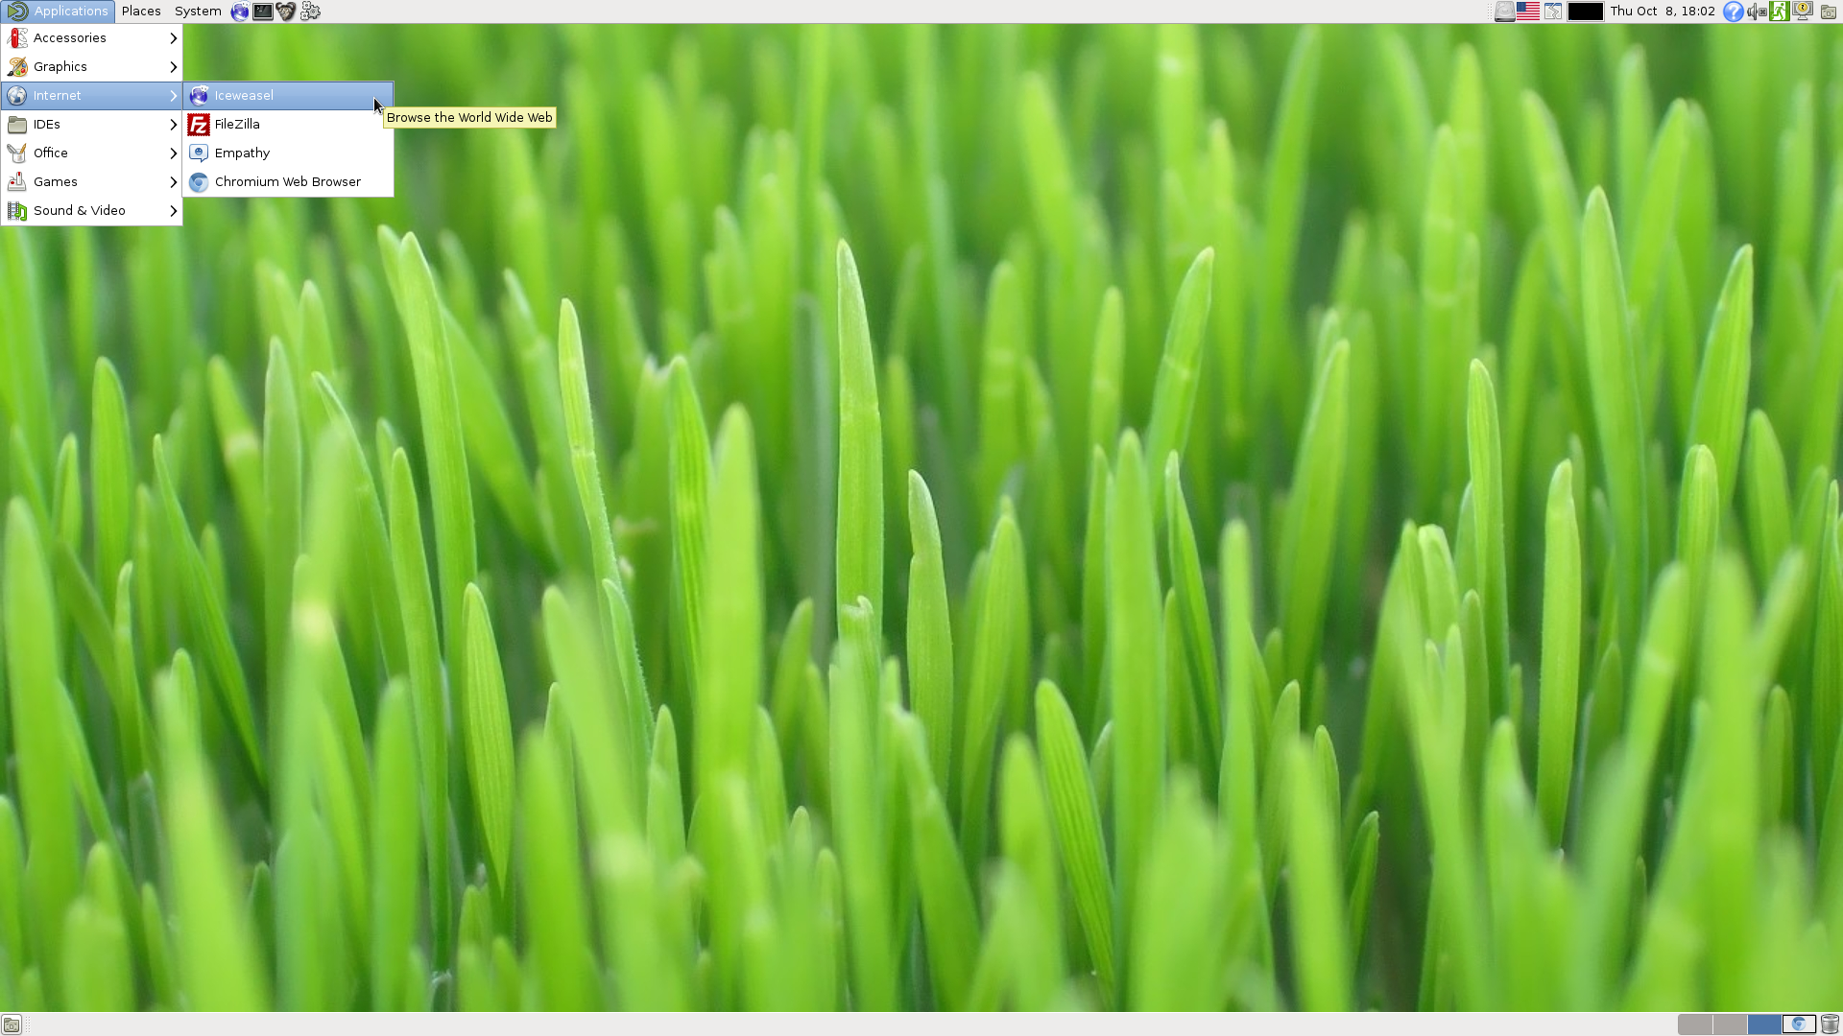
Or from here

Slide 23
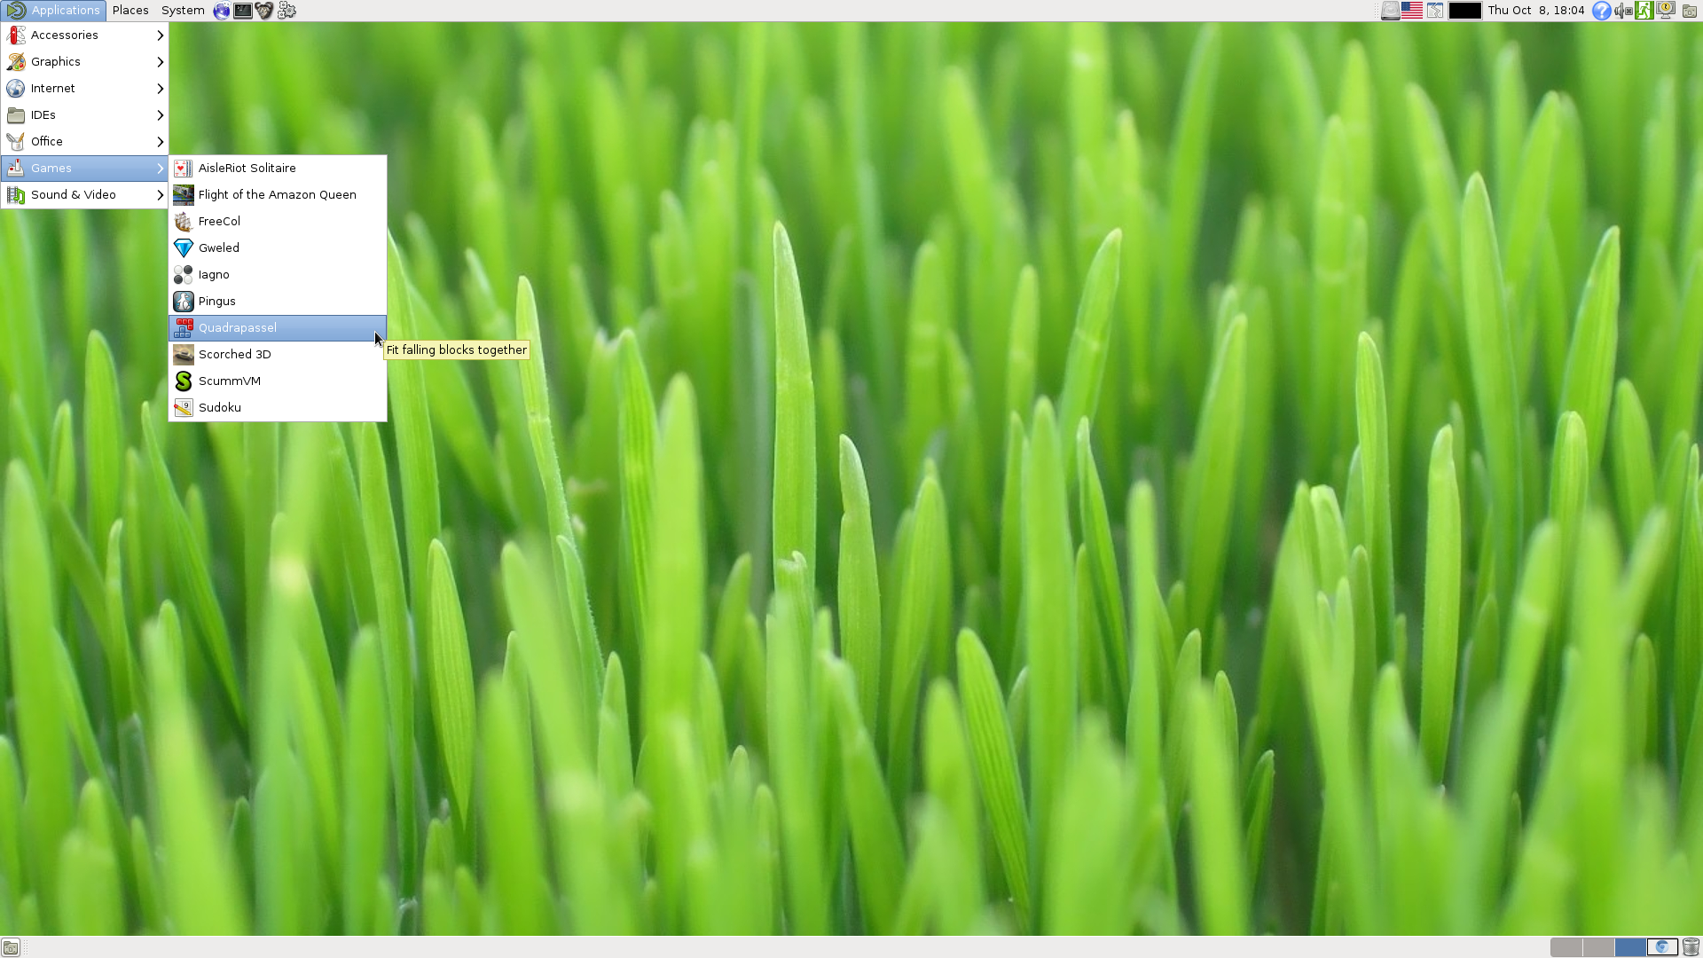
Explore other applications

Slide 24
Linux environment
In most of the OS we know (e.g. Window, Mac) we control the environment using a graphical user interface (GUI) : We click on symbols to launch applications and drag thumbnails to move files within the file system.
Linux allows using GUI but also has another very powerful tool - the terminal lets us communicate with the OS using a command line prompt.

Slide 25
Open the terminal

Slide 26
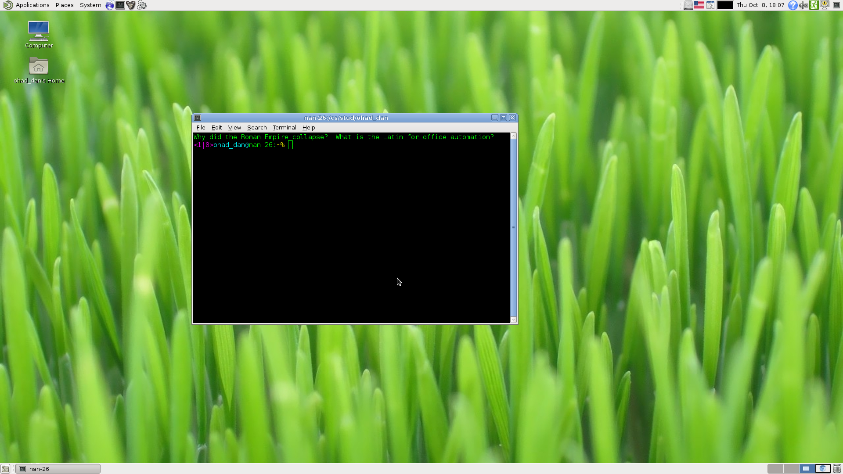

Slide 27
Creating a zip file using the terminal
A brief intro

Slide 28
A brief introduction to Linux command line
cd (change directory) - lets you browse within the file system.
When opening the terminal you always have a location within the file system. The default location is your home directory which has a special symbol to represent it ~ (tilde).
To navigate within the file system use the command cd path.
For example : cd Documents/intro_excercise
Home directory (~)
Documents
Desktop
intro_excercise
intro_lectures

Slide 29
A brief introduction to Linux command line
ls (list) - lists the files and directories in the current location
For example :
cd Documents/intro_excercise
ls
Result :
ex0
guidelines.docx
example.py
Home directory (~)
Documents
Desktop
intro_excercise
intro_lectures
ex0
guidelines.docx
example.py

Slide 30
A brief introduction to Linux command line
mkdir (make directory) - creates a new directory in current location
For example :
mkdir ex1
Home directory (~)
Documents
Desktop
intro_excercise
intro_lectures
ex1
ex0
guidelines.docx
example.py

Slide 31
A brief introduction to Linux command line
mv (move) - Move files from one directory to another
mv what where_to
For example :
mv example.py ex1/
Home directory (~)
Documents
Desktop
intro_excercise
intro_lectures
ex1
ex0
guidelines.docx
example.py

Slide 32
A brief introduction to Linux command line
zip - Group together and compress a list of file
zip new_zip_name file1 file2 file...
For example :
zip my_new_zip.zip ex1/example.py
Home directory (~)
Documents
Desktop
intro_excercise
intro_lectures
ex1
ex0
guidelines.docx
example.py

Slide 33
A brief introduction to Linux command line
ex1
Note if you don’t specify a name for the zip it will override the existing file
E.g. : zip 1.py 2.py
→ A new zip file was created, its name is 1.py and the previous content of 1.py is deleted.
Instead, remember to specify a name for the zip :
zip my_zip.zip 1.py 2.py
1.py
2.py
ex1
my_zip.zip
1.py
2.py

Slide 35
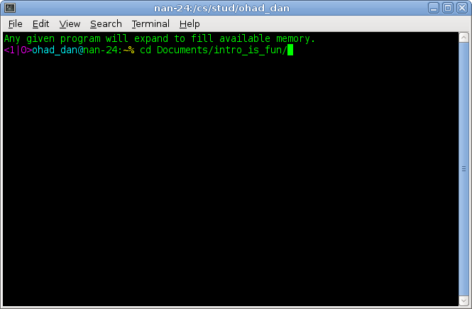
Create zip
cd to your
destination
folder

Slide 36
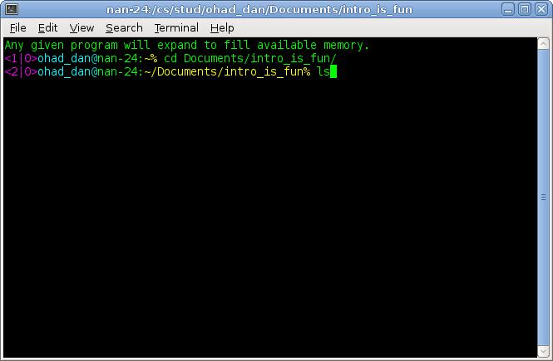
Create zip
Observe the files in current directory

Slide 37
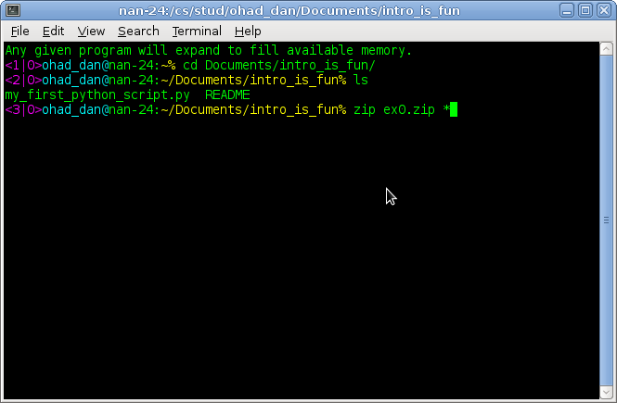
Create zip
Create a new zip whose name is ex0.zip which inclueds all the files in current folder (using the * wildcard)

Slide 38
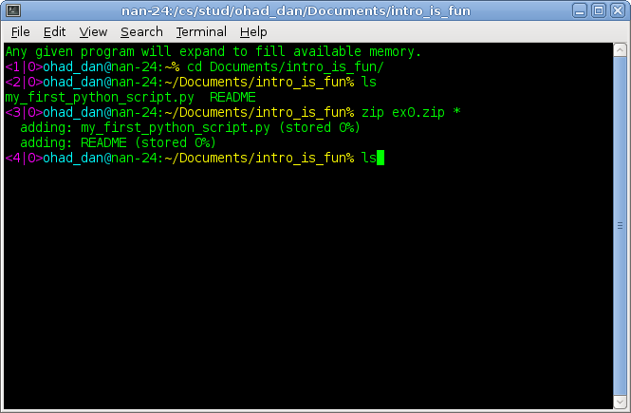
Create zip
ls to see it is there :

Slide 39
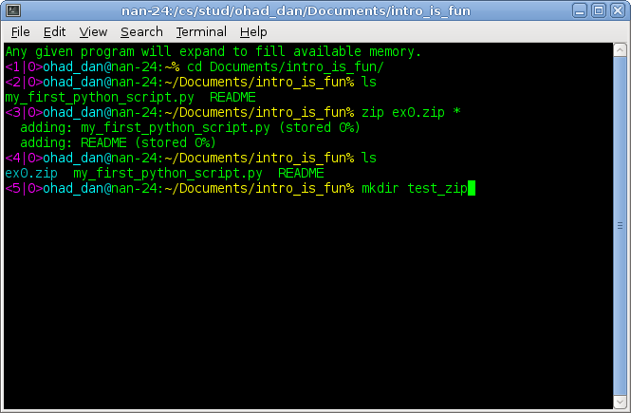
Create zip
Create a new folder to see the zip includes all the files you needed.

Slide 40
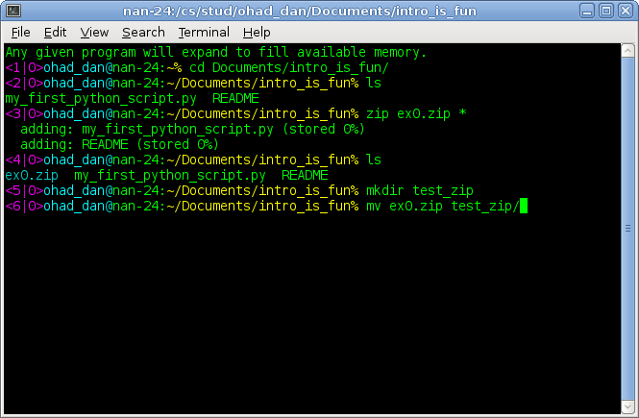
Create zip
Move the zip to that folder

Slide 41
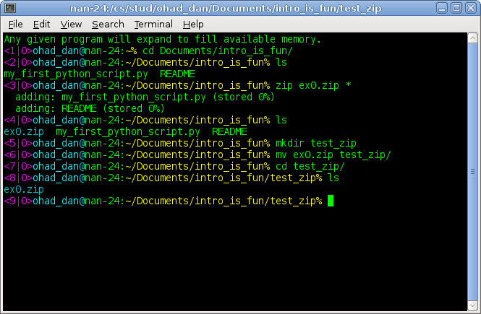
Create zip
Go to the test folder and see your zip is there.

Slide 42
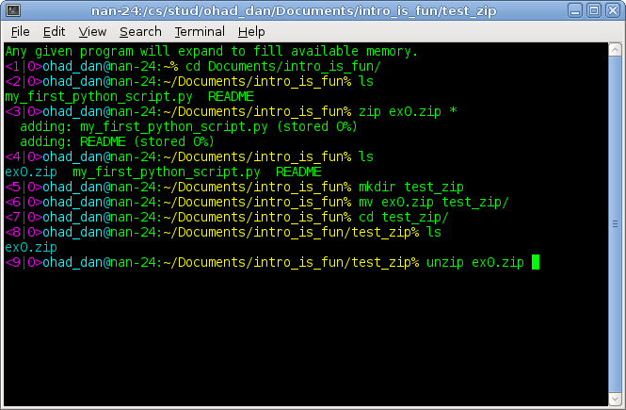
Create zip
Unzip to verify its content.

Slide 43
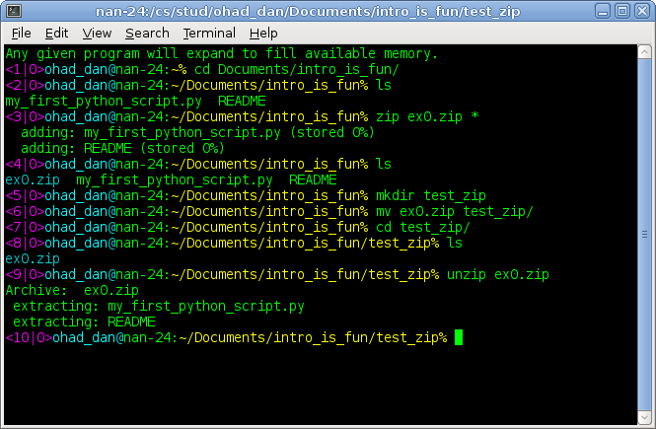
Create zip
Course 67100 will provide you with all the information you need to use Linux and more!

Slide 45
What is programming?
Programming is a process that leads from an original formulation of a computing problem to executable computer programs. [wikipedia]
A computing problem is a certain task you want to execute or problem you want to solve.
You make up a solution.
You create a list of orders (a program) which solves the problem.

Slide 46
What is programming?
Example - Which is the largest number in the list [6, 5, 1024 , 4, 3] ?
Computing problem - Finding the largest number.
Solution :
Draw a rectangle

Slide 47
What is programming?
Example - Which is the largest number in the list [6, 5, 1024 , 4, 3] ?
Computing problem - Finding the largest number.
Solution :
Draw a rectangle
Call it “The largest number so far”

Slide 48
What is programming?
Example - Which is the largest number in the list [6, 5, 1024 , 4, 3] ?
Computing problem - Finding the largest number.
Solution :
Draw a rectangle
Call it “The largest number so far”
Write inside it the first number
largest_so_far

Slide 49
What is programming?
Example - Which is the largest number in the list [6, 5, 1024 , 4, 3] ?
Computing problem - Finding the largest number.
Solution :
Draw a rectangle
Call it “The largest number so far”
Write inside it the first number
Put your finger on the second number in the list
largest_so_far
6

Slide 50

What is programming?
Example - Which is the largest number in the list [6, 5, 1024 , 4, 3] ?
Computing problem - Finding the largest number.
Solution :
Draw a rectangle
Call it “The largest number so far”
Write inside it the first number
Put your finger on the second number in the list
If the number you are pointing at is larger than the one in the rectangle, replace the number in the box with the one you are pointing at
largest_so_far
6

Slide 51
What is programming?
Example - Which is the largest number in the list [6, 5, 1024 , 4, 3] ?
Computing problem - Finding the largest number.
Solution :
Draw a rectangle
Call it “The largest number so far”
Put your finger on the second number in the list
If the number you are pointing at is larger than the one in the rectangle, replace the number in the box with the one you are pointing at
continue until you reach the end of the list
largest_so_far
1024

Slide 52
What is programming?
Example - Which is the largest number in the list [6, 5, 1024 , 4, 3] ?
Computing problem - Finding the largest number.
Solution :
Draw a rectangle
Call it “The largest number so far”
Put your finger on the second number in the list
If the number you are pointing at is larger than the one in the rectangle, replace the number in the box with the one you are pointing at
continue until you reach the end of the list
largest_so_far
1024

Slide 53
What is programming?
Example - Which is the largest number in the list [6, 5, 1024 , 4, 3] ?
Computing problem - Finding the largest number.
Solution :
Draw a rectangle
Call it “The largest number so far”
Put your finger on the second number in the list
If the number you are pointing at is larger than the one in the rectangle, replace the number in the box with the one you are pointing at
continue until you reach the end of the list
You now have the largest number inside the rectangle.
largest_so_far
1024

Slide 54
What is programming?
Here is a list of commands which solve the problem.
Who can execute these instruction? Anyone.
If we want the computer to execute them, we need to explain it to it using a language it understand - A programming language
Draw a rectangle
Call it “The largest number so far”
Put your finger on the second number in the list
If the number you are pointing at is larger than the one in the rectangle, replace the number in the box with the one you are pointing at,
continue until you reach the end of the list
You now have the largest number inside the rectangle.

Slide 55


What is a Programming language
Python is a programming language, a language designed to communicate instructions to the computer.
You’ll meet many more during your degree : Java, C, C++ …
Python is a great choice for beginner programmer as it very intuitive and it’s very easy to write and run basic programs.
Python has 2 main versions :
Python2 (not in development any more)
Python3 (that’s the one we’ll use, specifically 3.7)

Slide 56
Introduction to Python
Write a Python program - To create a text file which contains legal Python syntax (words and sentences).
The suffix of Python scripts are .py
Run a Python program - Ask the computer (the Python interpreter) to execute the orders listed in the the text file.
How do we create these text files?
We can use any text editor (e.g. notepad) but it’s easier to use a dedicated Python editor. The one we recommend is PyCharm.

Slide 57

Using Python on Windows
Download and install WinPython (see installation instructions)
The Python editor we recommend is PyCharm

Slide 58
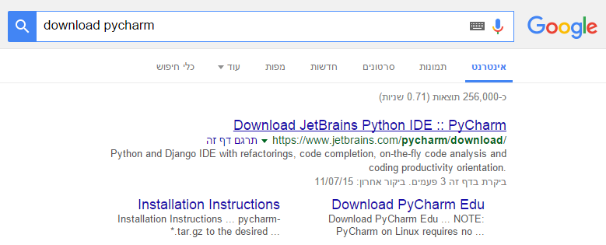
Downloading PyCharm
Google it (or find it here)

Slide 59
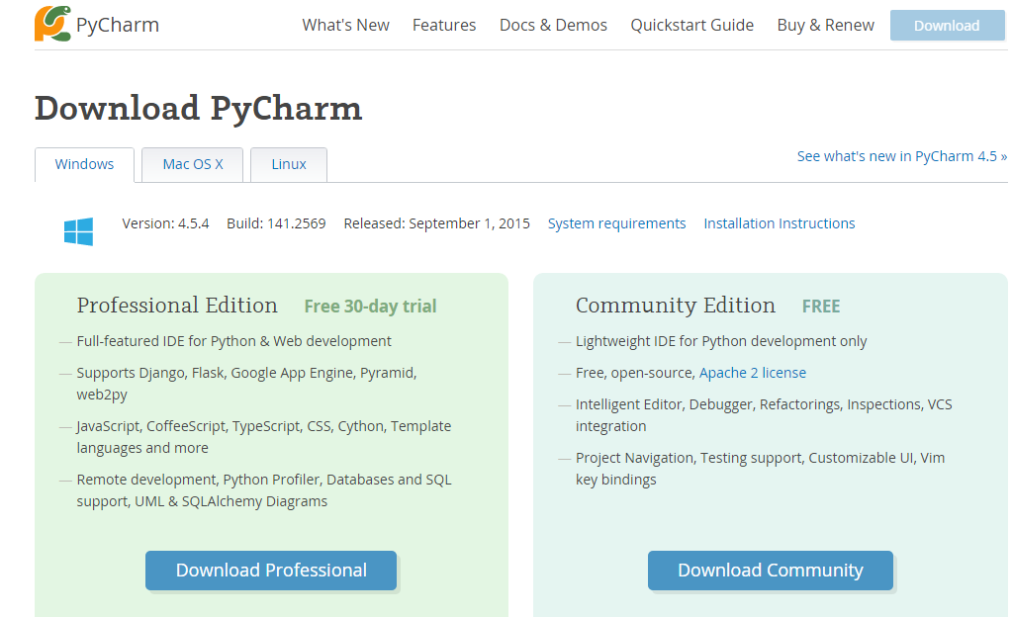
Downloading PyCharm
Google it (or find it here)
Choose your OS

Slide 60
Downloading PyCharm
Google it (or find it here)
Choose your OS
Download the community edition

Slide 61
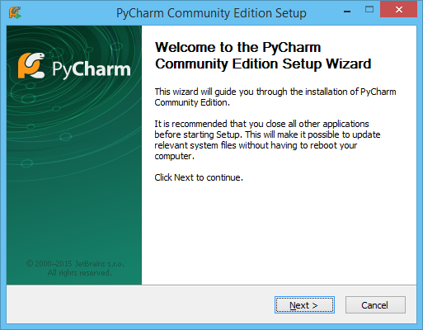
Downloading PyCharm
Google it (or find it here)
Choose your OS
Download the community edition
Install it → Next

Slide 62
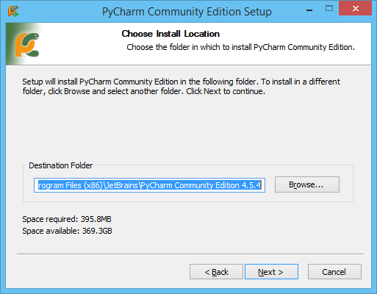
Downloading PyCharm
Google it (or find it here)
Choose your OS
Download the community edition
Install it → Next → Choose installation destination

Slide 63
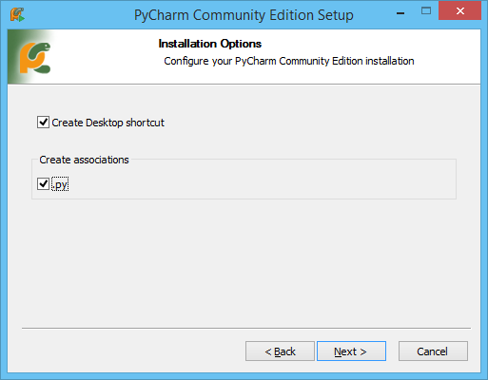
Downloading PyCharm
Google it (or find it here)
Choose your OS
Download the community edition (Next → Next → Next →)
Install it → Next → Choose installation destination → Mark options

Slide 64
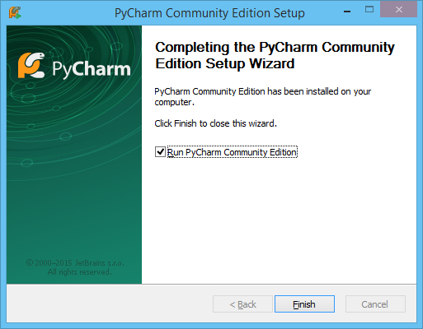
Downloading PyCharm
Google it (or find it here)
Choose your OS
Download the community edition
Install it → Next → Choose installation destination → Mark options → Install → Finish, you got it

Slide 65
PyCharm is already installed in CS labs
To launch PyCharm from Linux : Open the terminal

Slide 66

Type :
pycharm &
Press Enter
Launch Pycharm

Slide 67
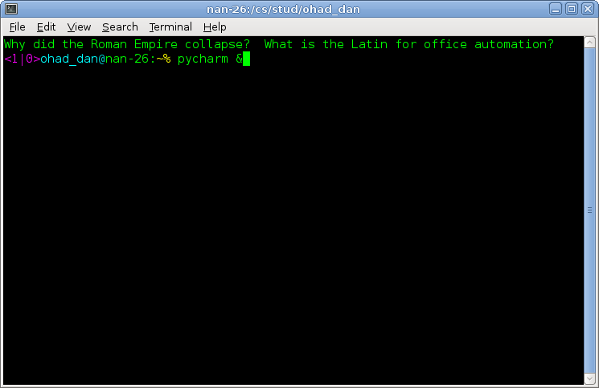

Slide 68
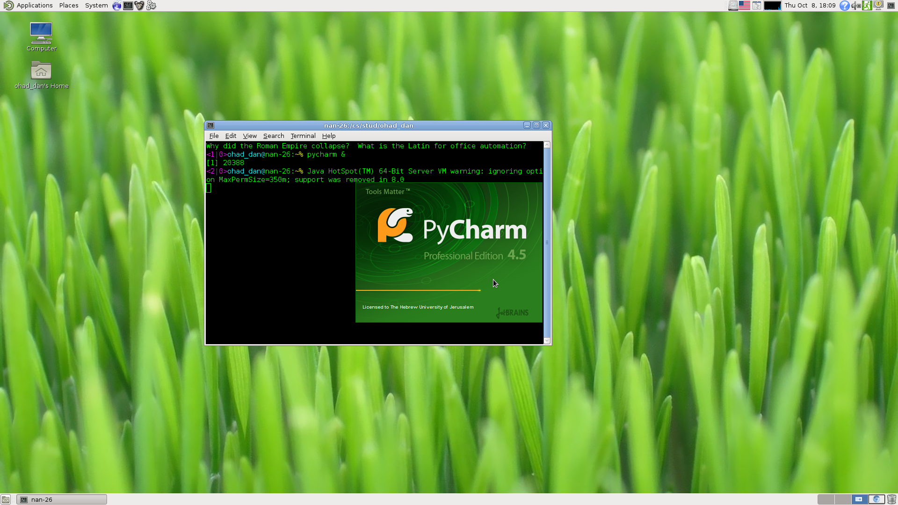

Slide 69
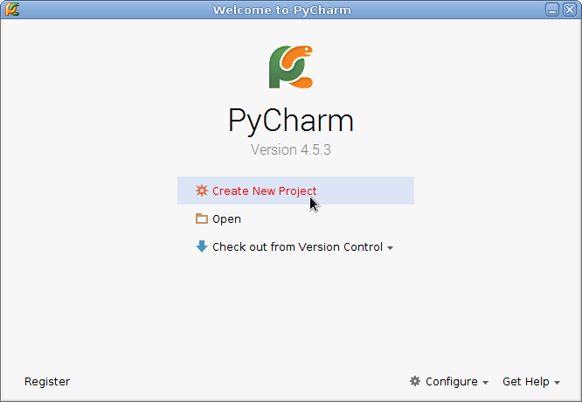
Create new project

Slide 70
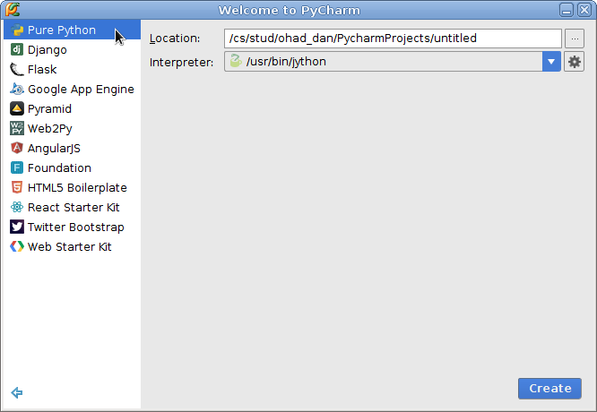
Choose Pure Python

Slide 71
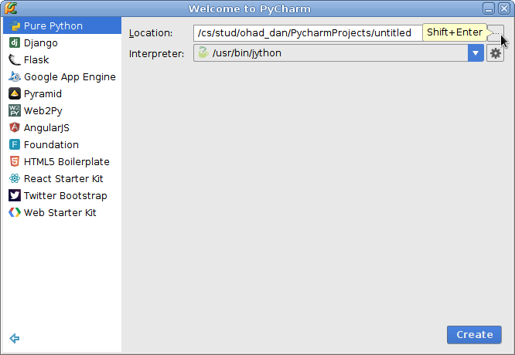
Choose a folder for the project

Slide 72
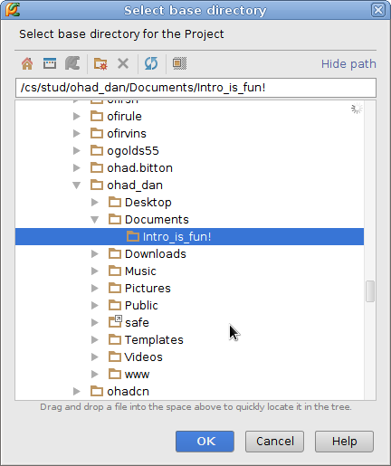

Slide 73
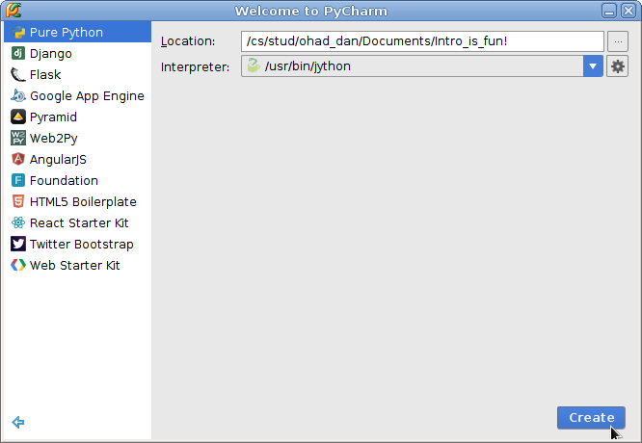
Create the project

Slide 74
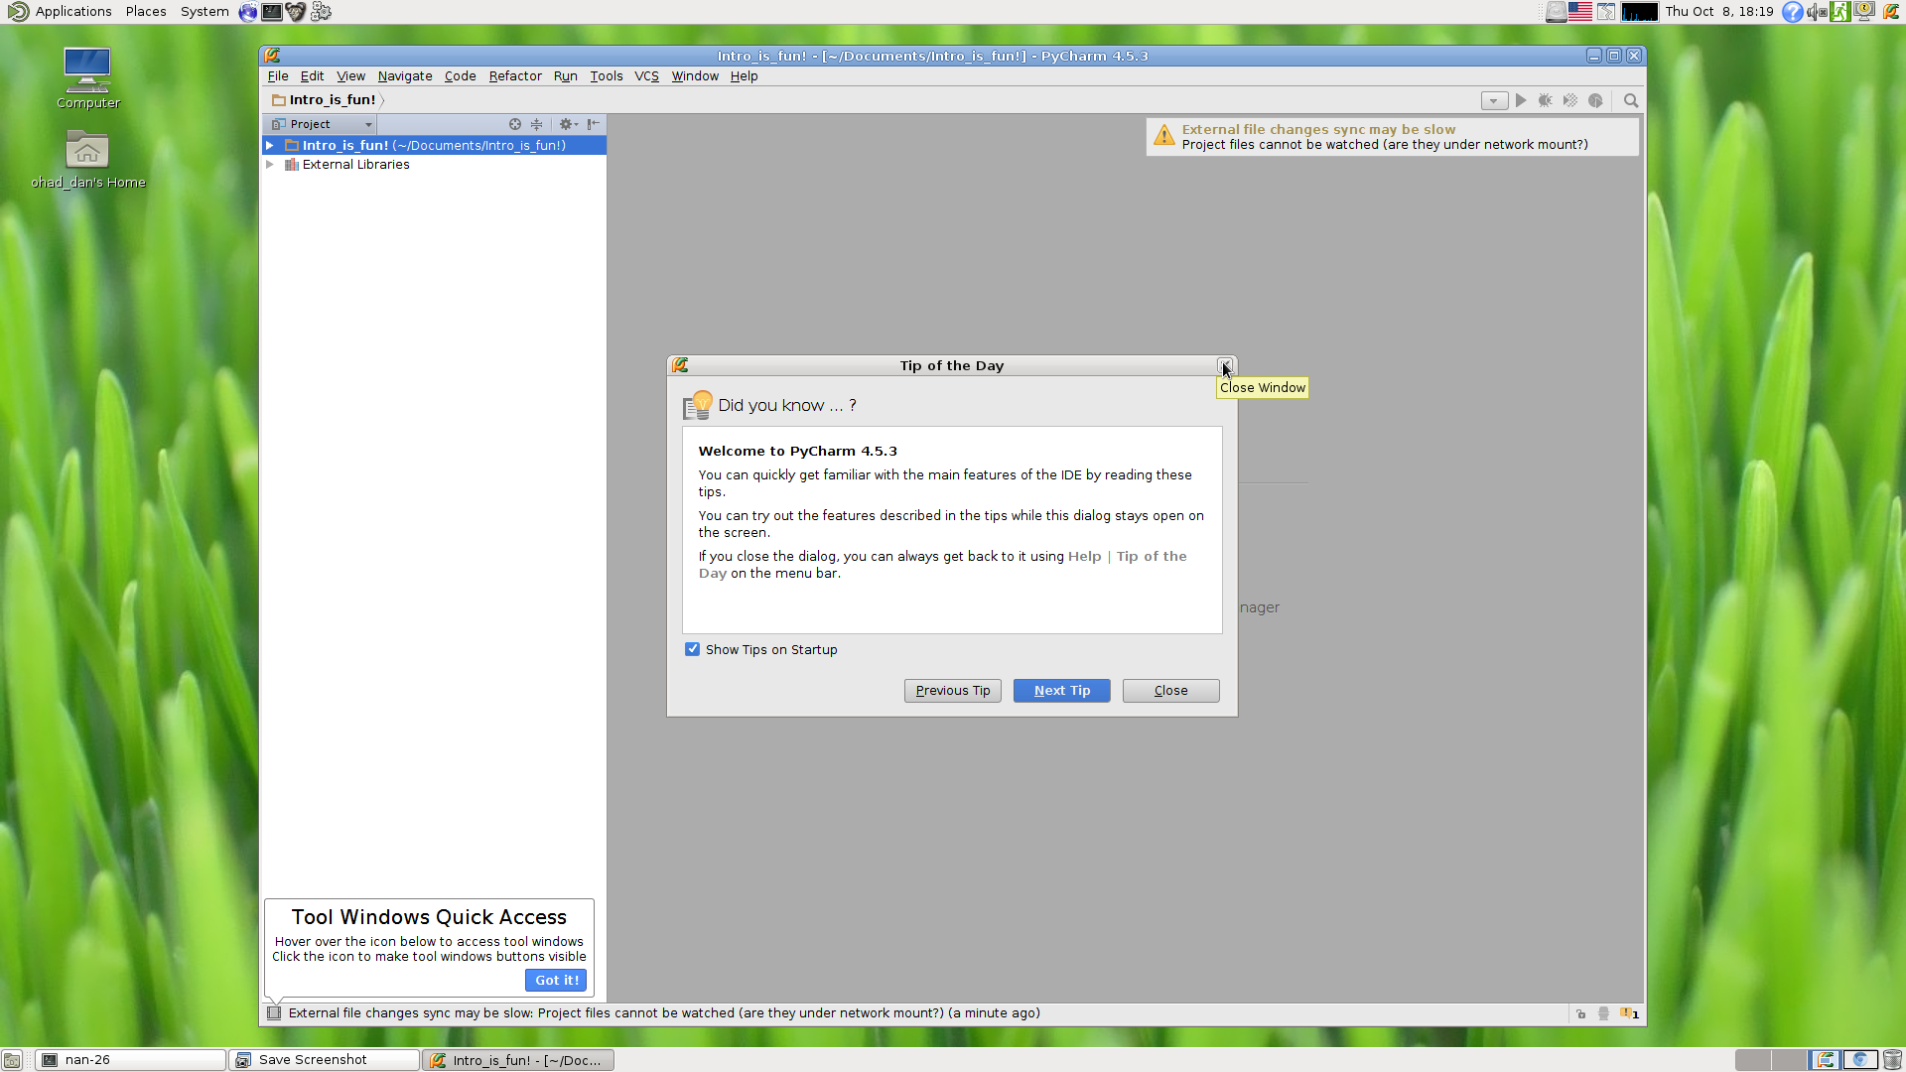
Enjoy the tip of the day

Slide 75
Here is your project

Slide 76
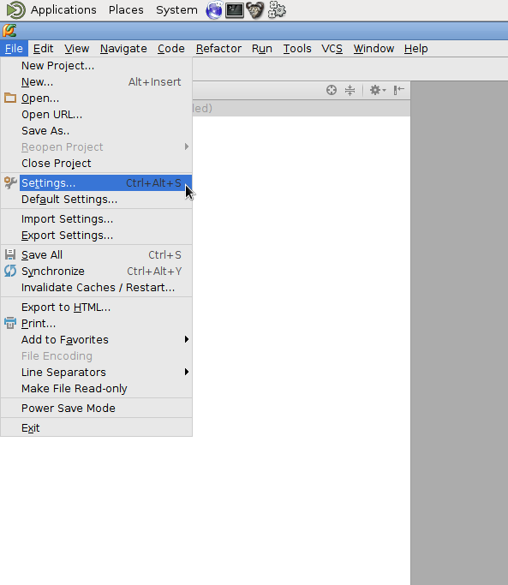
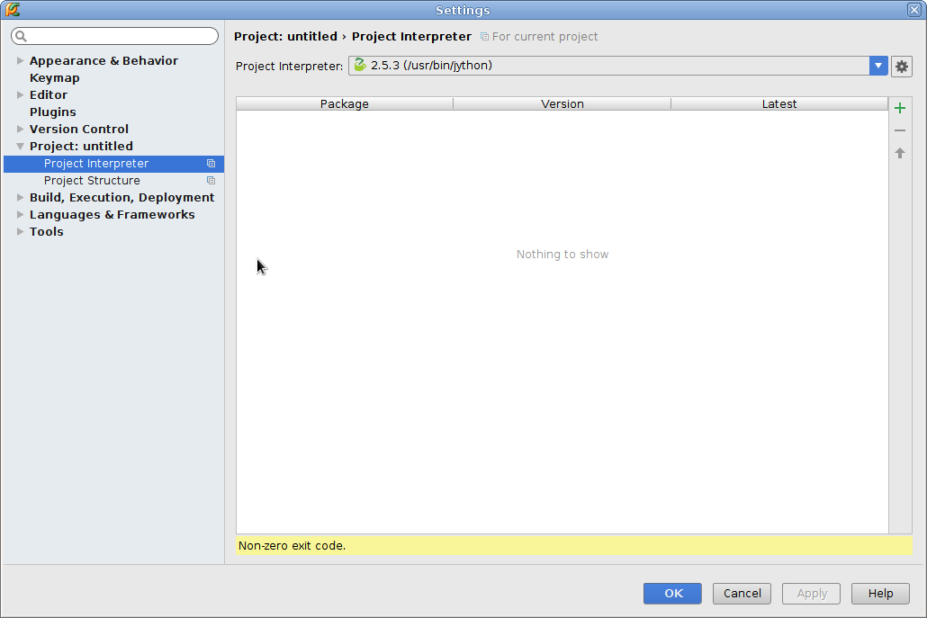
Make sure you use Python3 interpreter
File → Settings → Project → Project interpreter

Slide 77
Make sure you use Python3 interpreter - On Windows
If you go to :
File → Settings → Project → Project interpreter
and have no interpreters to choose from, you need to direct PyCharm to the local python installation you made (when installing WinPython)

Slide 78
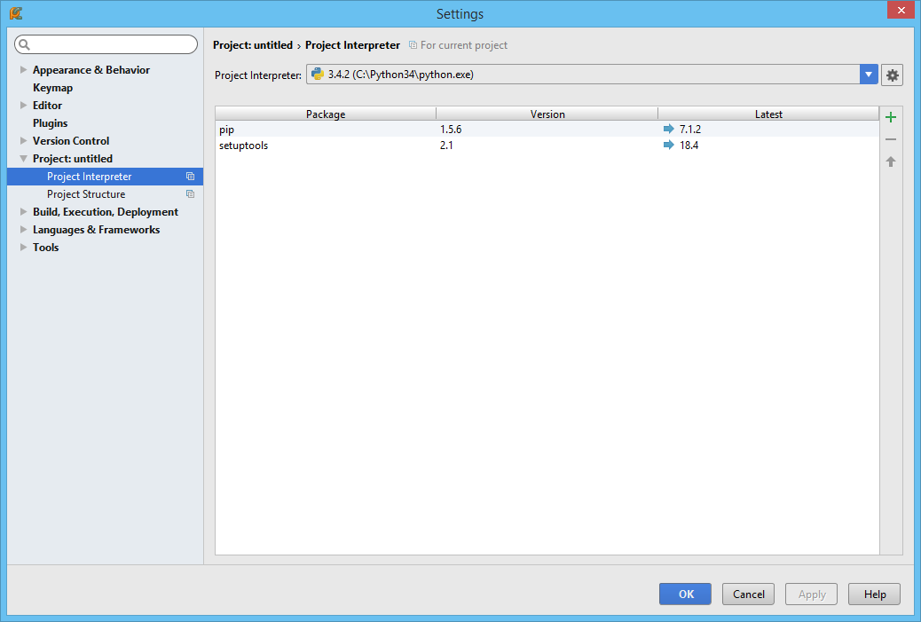
Make sure you use Python3 interpreter - On Windows
Press the configuration button

Slide 79
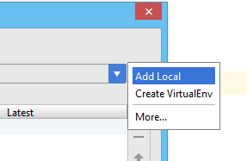
Make sure you use Python3 interpreter - On Windows
Choose “Add Local”

Slide 80
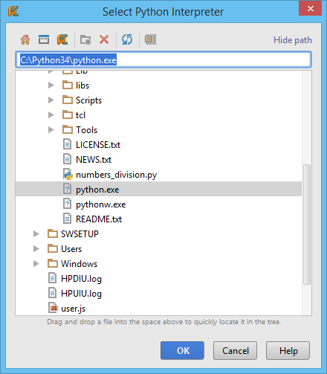
Make sure you use Python3 interpreter - On Windows
Browse to a python.exe file on your local computer (usually at : C:\Python34\python.exe)

Slide 81
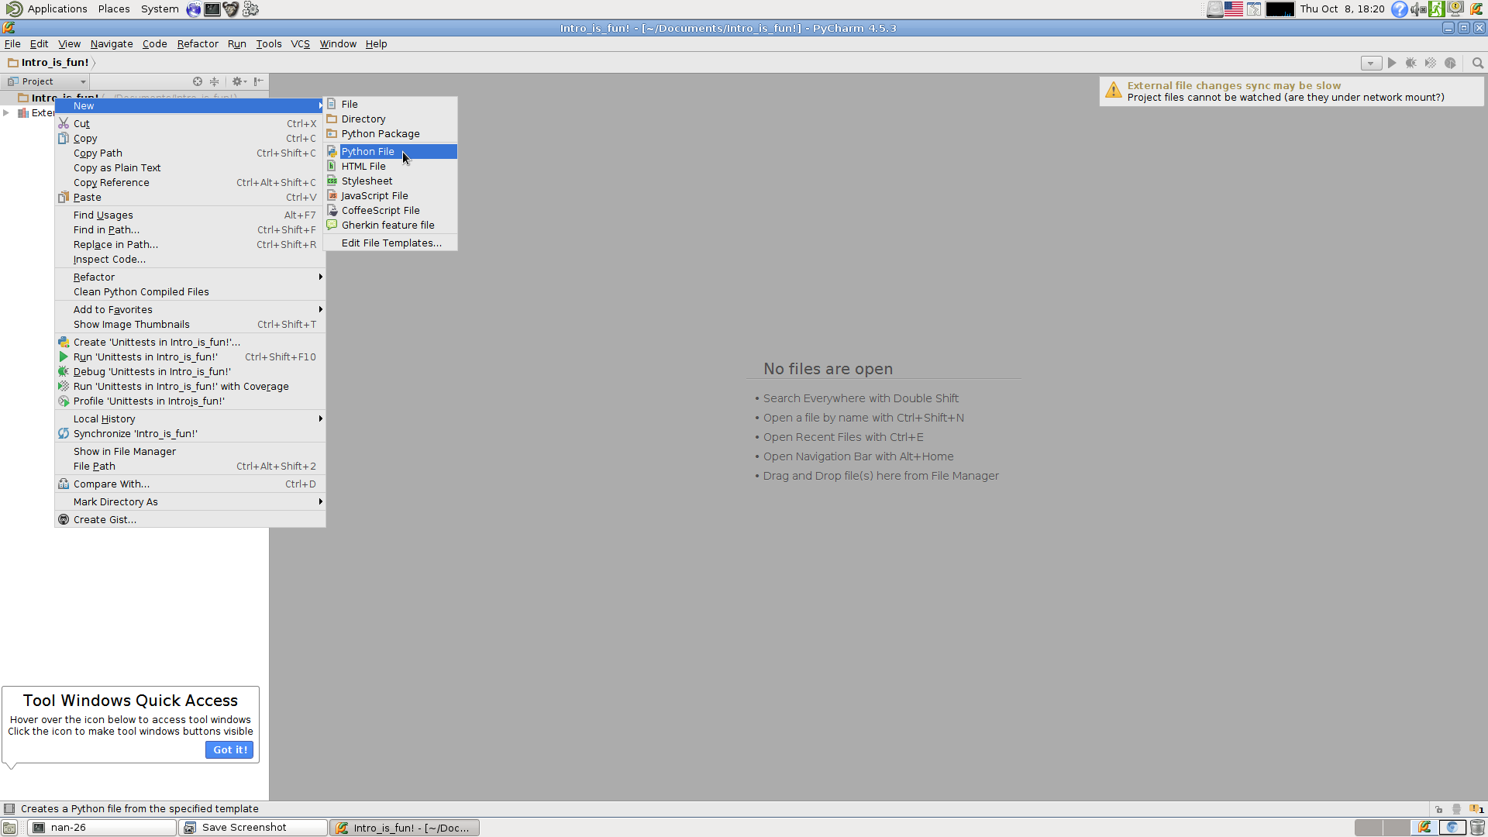
Right click your project and create a new python file

Slide 82
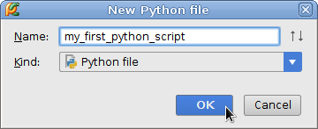
Name it

Slide 83
First Python command - Print
print is a function which prints messages to the screen.
Examples : print('Message 1')
Note :
Python is case sensitive so PRINT or Print won’t work
You should use (parentheses) to enclose the message you wish to print
The printed text could be wrapped within either single (‘) or double (“) quotes, just be sure to use the same one for open and close

Slide 84
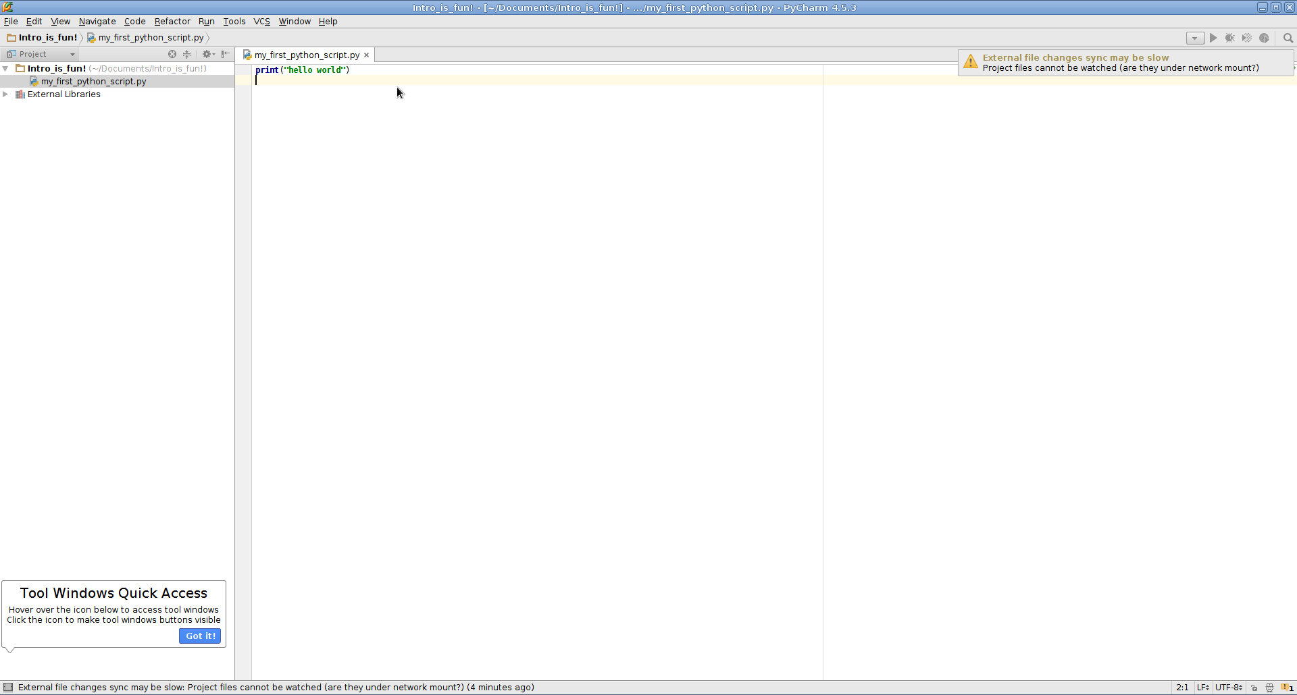
Write some code

Slide 85
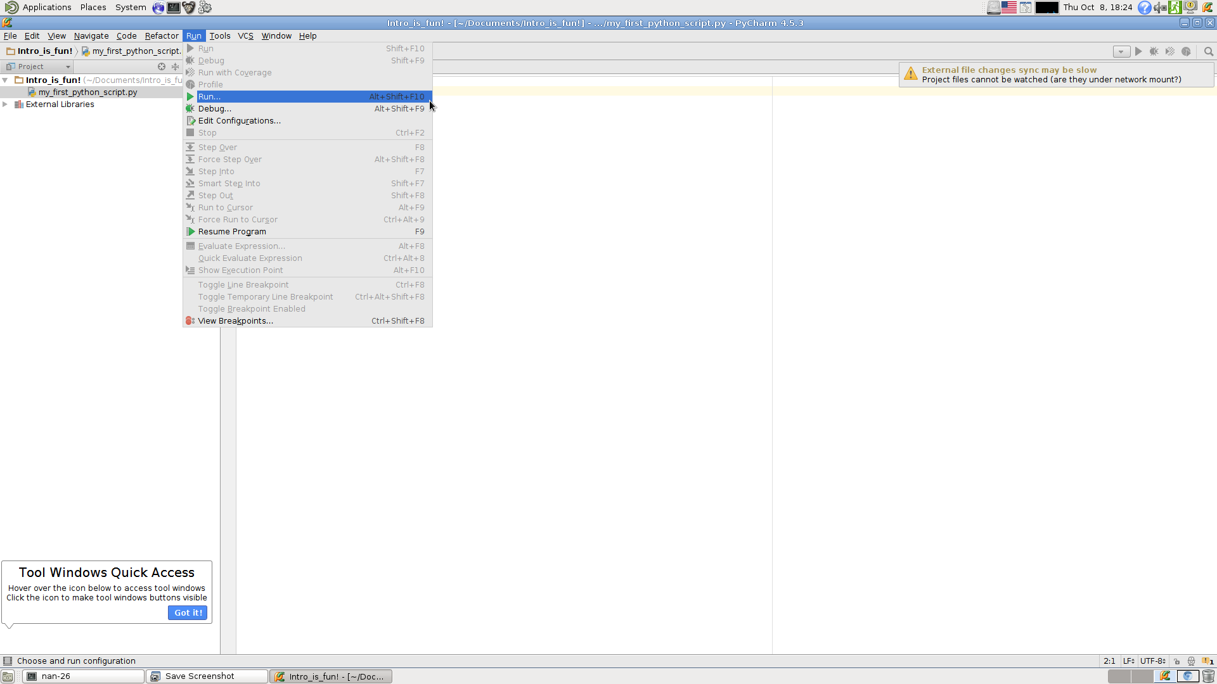
Run it!

Slide 86
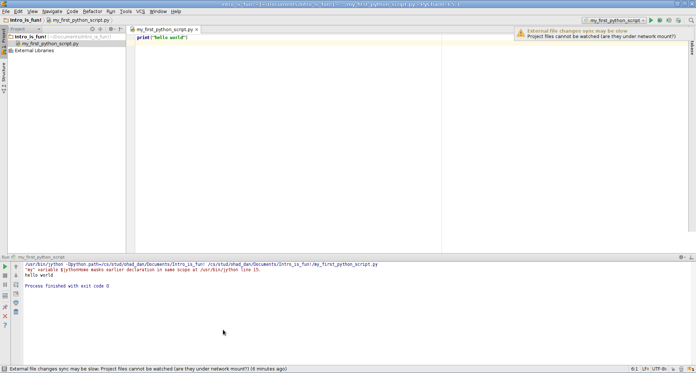
Observe the results

Slide 87
Using the console
Sometimes we want to try out some code without having to open a new script for it, to do this we can use the console.
The console interpret Python command as they are typed down - we don’t have to create a file, save it and run it.

Slide 88
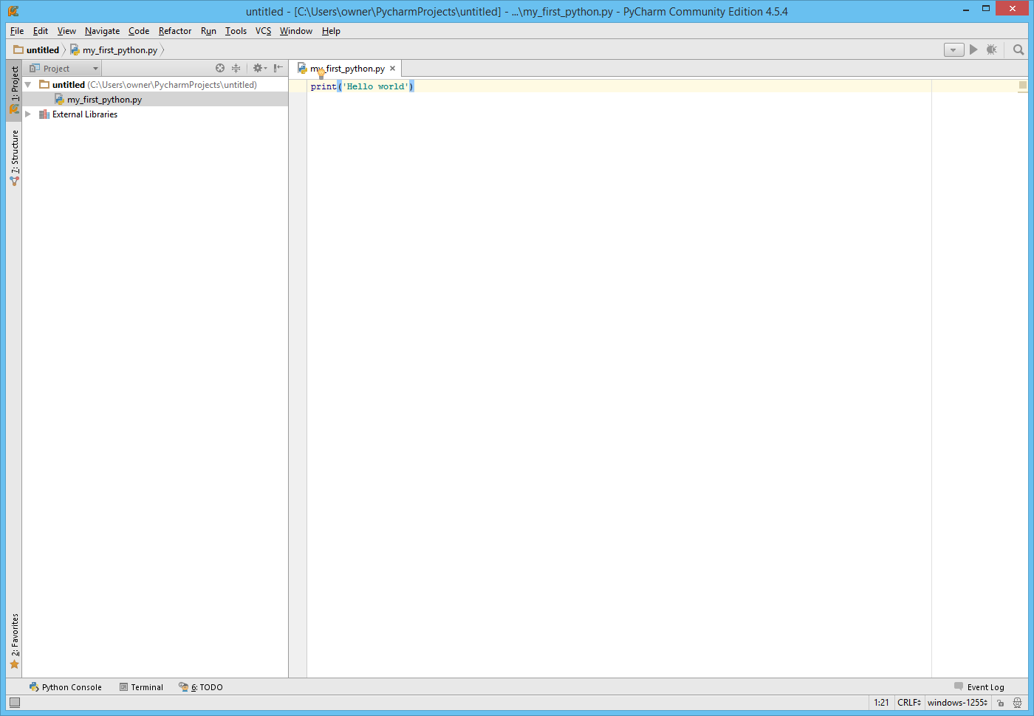
Where to find the console

Slide 89
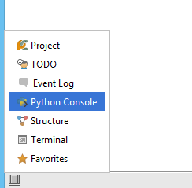
Where to find the console

Slide 90
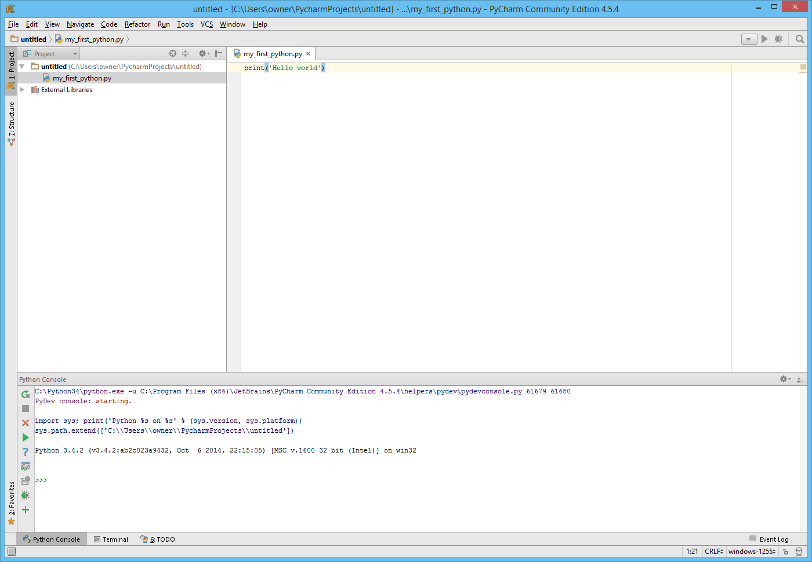
Where to find the console
You can write your commands here

Slide 91
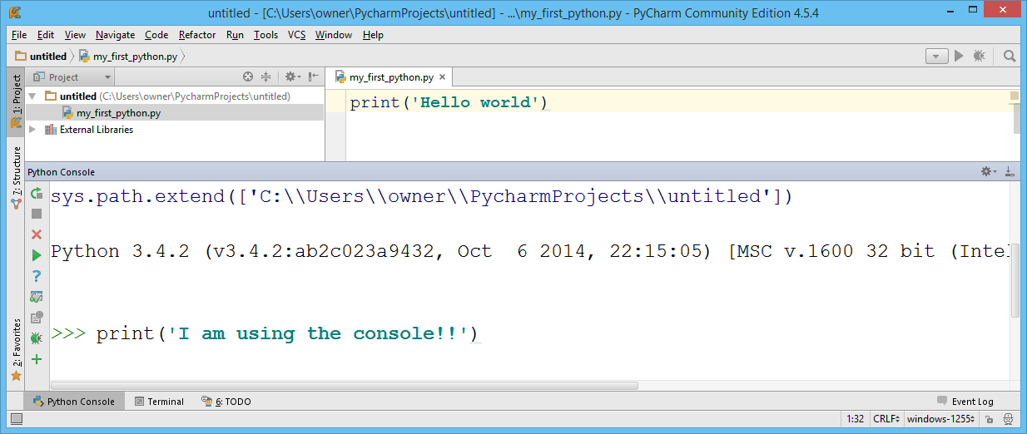
Using the console
Press Enter

Slide 92
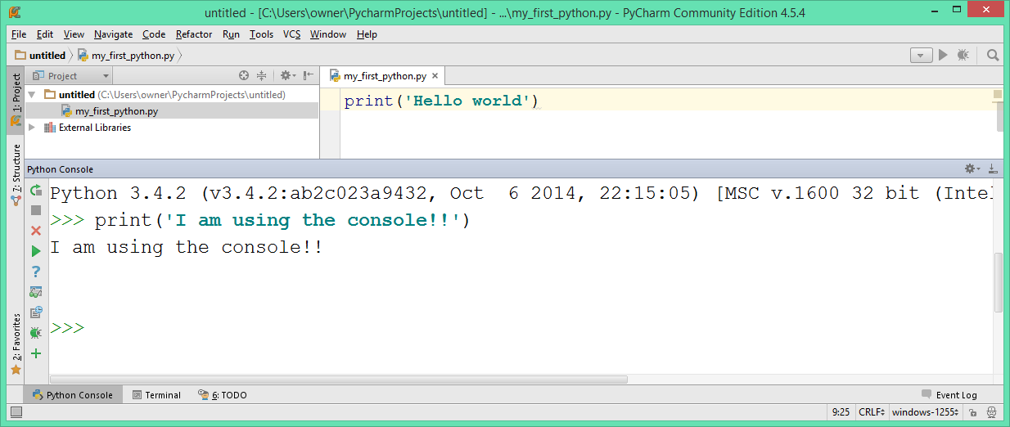
Using the console
Your output

Slide 93
The console is very useful
Another example, Does Python know how to multiply numbers?
Let’s check!

Slide 94
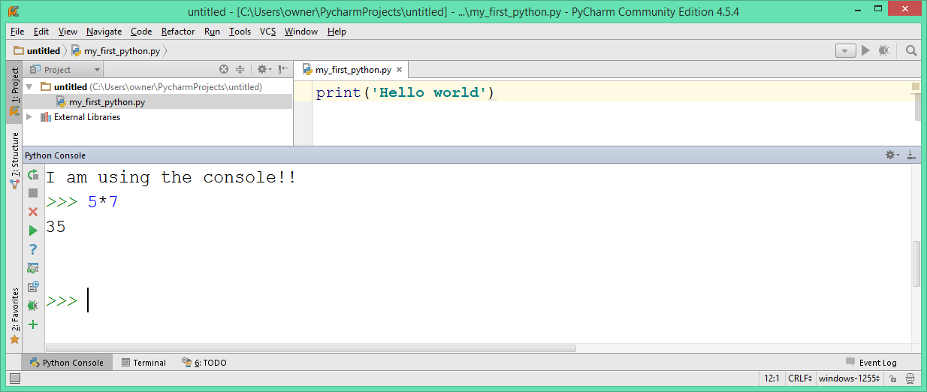
The console is very useful
Yes, Python knows how to multiply numbers

Slide 96

Turtle
Turtle is a Python module which can be used for drawing
Turtle has 5 basic functions :
down() - Put a ”pen” on the “canvas”
up() - Remove a “pen” from the “canvas”
forward(n) - Move the turtle n steps forward
right(d) - Turn turtle’s head in d degrees right
left(d) - Turn turtle’s head in d degrees right
right(d)
left(d)
forward(n)

Slide 97
Turtle
To get started with turtle add 2 special lines :
In the beginning of our file : import turtle
In the end of our file : turtle.done()

Slide 98
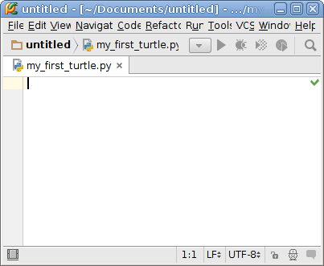
Turtle example
Open a new python file, call it my_first_turtle.py

Slide 99
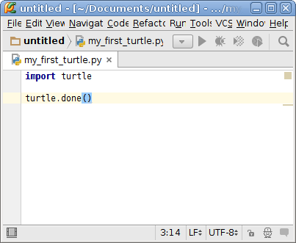
Turtle example
Add the special first and last lines

Slide 100
Turtle example
To make the turtl move use the following commands (note the turtle prefix):
turtle.up()
turtle.down()
turtle.forward(n)
turtle.left(n)
turtle.right(n)

Slide 101


Turtle example
Make the turtle move 100 steps forward.
Run your program
→

Slide 102

Turtle example
Result :

Slide 103
Turtle more complex example
Let’s draw a rectangle -
4 X (Go 100 steps, turn right)
forward(100)
right(90)
1
2
forward(100)
forward(100)
4
3
right(90)
forward(100)
right(90)

Slide 104


Turtle more complex example

Slide 105
When things go wrong…
Error messages are Python’s way to inform that some parts of the code are incorrect. Bad syntax examples (_ means space or missing character):
prinx('Hello world')
Print('Hello world')
print('Hello world_)
print('Hello world'_
print(_Hello world_)
print[Hello world]
pri_nt('Hello world')
prinnt('Hello world')

Slide 106
When things go wrong…
Handling error messages – DON’T PANIC
Error messages are there to help you, read them calmly:
Traceback (most recent call last):
File "C:\Users\Ohad\Desktop\turtle_example.py", line 86, in <module>
prinx('Hello world')
NameError: name 'prinx' is not defined

Slide 107
When things go wrong…
The error occurred at this file
Traceback (most recent call last):
File "C:\my_code\ex0.py", line 86, in <module>
prinx('Hello world')
NameError: name 'prinx' is not defined

Slide 108
When things go wrong…
The error occurred in this line of code
Traceback (most recent call last):
File "C:\my_code\ex0.py", line 86, in <module>
prinx('Hello world')
NameError: name 'prinx' is not defined

Slide 109
When things go wrong…
While trying to execute this term
Traceback (most recent call last):
File "C:\my_code\ex0.py", line 86, in <module>
prinx('Hello world')
NameError: name 'prinx' is not defined

Slide 110
When things go wrong…
The type of error is something related to a name (NameError)
Traceback (most recent call last):
File "C:\my_code\ex0.py", line 86, in <module>
prinx('Hello world')
NameError: name 'prinx' is not defined

Slide 111
When things go wrong…
The error is we tried to use the name 'prinx' but it is not defined.
Traceback (most recent call last):
File "C:\my_code\ex0.py", line 86, in <module>
prinx('Hello world')
NameError: name 'prinx' is not defined

Slide 112
When things go wrong…
Read calmly → Easy to understand and fix ☺
Traceback (most recent call last):
File "C:\my_code\ex0.py", line 86, in <module>
prinx('Hello world')
NameError: name 'prinx' is not defined

Slide 113
What are functions good for?
Functions let us group together a number of commands
Breaks a long code into small pieces - more readable, easier to understand.
Allow code reuse.
Functions should be short.
Functions should have 1 distinct role.
If a function has 2 roles, split it into 2 functions.

Slide 114
Python functions - syntax
def function_name():
your indented code here
We use indentation to tell Python what lines of code belong to a specific function.
Indentation is composed of 4 space characters.
Do not forget the parentheses after the function name.
Do not forget the colon at the end of the line

Slide 115
Python functions - syntax
def function_1():
do this
do that
def function_2():
do this
do that
print('Hello world')
How did Python know that function_2 is not part of the definition of function_1?
How did Python know that the print command is not part of the definition of function_2?
Because of their indentations.

Slide 116
Calling functions
def print_welcome_message():
print('Hello world')
print('Nice to meet you')
print_welcome_message()
>>>Hello world
>>>Nice to meet you
Calling a function means to make it run all the lines indented under it.
To call a function, we write its name and parentheses.

Slide 117
Calling functions for ex1 (and the next exercises)
In ex1 (and following exercises to come) we must call the functions in the following form :
if __name__ == “__main__”:
call_function()

Slide 118
Calling functions for ex1 - example
In ex1 (and following exercises to come) we must call the functions in the following form :
def print_welcome_message():
print('Hello world')
print('Nice to meet you')
if __name__ == “__main__”:
print_welcome_message()
>>>Hello world
>>>Nice to meet you

Slide 119


Python functions - Example
Function definition

Slide 120
Python functions - Example
Function content
(note the indentation)

Slide 121



Python functions calling functions

Slide 122

Python functions calling functions calling functions
def draw_rectangle():
turtle.forward(100)
turtle.right(90)
turtle.forward(100)
turtle.right(90)
turtle.forward(100)
turtle.right(90)
turtle.forward(100)
turtle.right(90)
def multi_square():
draw_rectangle()
turtle.right(45)
draw_rectangle()
turtle.right(45)
draw_rectangle()
turtle.right(45)
draw_rectangle()
turtle.right(45)
draw_rectangle()
turtle.right(45)
draw_rectangle()
turtle.right(45)
draw_rectangle()
turtle.right(45)
draw_rectangle()
turtle.right(45)
def many_multi_square():
multi_square()
turtle.up()
turtle.forward(300)
turtle.down()
multi_square()
many_multi_square()
Notes:
import turtle
def draw_rectangle():
turtle.forward(100)
turtle.right(90)
turtle.forward(100)
turtle.right(90)
turtle.forward(100)
turtle.right(90)
turtle.forward(100)
turtle.right(90)
def multi_square():
draw_rectangle()
turtle.right(45)
draw_rectangle()
turtle.right(45)
draw_rectangle()
turtle.right(45)
draw_rectangle()
turtle.right(45)
draw_rectangle()
turtle.right(45)
draw_rectangle()
turtle.right(45)
draw_rectangle()
turtle.right(45)
draw_rectangle()
turtle.right(45)
def many_multi_square():
multi_square()
turtle.up()
turtle.forward(300)
turtle.down()
multi_square()
many_multi_square()
turtle.done()

Slide 123
When functions go wrong (error message examples)
Invalid syntax
(missing colon)
def print_hi()
print('hi')
print_hi()
Expected an indented block
(no indentation)
def print_hi():
print('hi')
print_hi()
No print
(calling print_hi without paranthesis)
def print_hi():
print('hi')
print_hi

Slide 124

More Turtle
Let’s write some numbers using turtle

Slide 125
More Turtle
Write the number 1.
turtle.right(45-)
turtle.forward(50)
turtle.right(135)
turtle.forward(200)
Start

Slide 126
More Turtle
Write the number 1.
Let’s put it in a function!
Start
def print_1():
turtle.right(45-)
turtle.forward(50)
turtle.right(135)
turtle.forward(200)

Slide 127

More Turtle
Write the number 8.
def draw_8():
draw_rectangle()
turtle.right(90)
turtle.forward(100)
turtle.right(-90)
draw_rectangle()

Slide 128

More Turtle
turtle.right(-45)
turtle.forward(50)
turtle.right(135)
turtle.forward(200)
turtle.up()
turtle.right(-90)
turtle.forward(30)
turtle.right(-90)
turtle.forward(200)
turtle.right(90)
turtle.down()
draw_rectangle()
turtle.right(90)
turtle.forward(100)
turtle.right(-90)
draw_rectangle()
Write 1
Write the number 18.
Move back
up
Write 8

Slide 129
More Turtle
turtle.right(-45)
turtle.forward(50)
turtle.right(135)
turtle.forward(200)
turtle.up()
turtle.right(-90)
turtle.forward(30)
turtle.right(-90)
turtle.forward(200)
turtle.right(90)
turtle.down()
draw_rectangle()
turtle.right(90)
turtle.forward(100)
turtle.right(-90)
draw_rectangle()
Write 1
write_1()
turtle.up()
turtle.right(-90)
turtle.forward(30)
turtle.right(-90)
turtle.forward(200)
turtle.right(90)
turtle.down()
Write_8()
Write the number 18.
Move back
up
Write 8
This works
That’s Better

Slide 130

More Turtle
write_8()
turtle.up()
turtle.forward(130)
turtle.right(-90)
turtle.forward(65)
turtle.right(90)
turtle.down()
write_1()
Write 8
code reuse
Write the number 81.
Move back
up
Write 1
code reuse

Slide 131
Summary
We learned how to use PyCharm (either from our PCs or from CS labs) to create a Python program and run it.
We got acquainted with the print() function and the turtle module.
We learned how functions are constructed (def function_name: ), how to use indentation to enclose the function’s content and how to call a function.
ex1 is already online

